Slide 1
DX BALL
A Project for C++
Team Members:
Pranjal Dhakal
Prateek Raj Joshi
Satish Pant

Slide 2
Introduction:
DX ball is a simple game made by using C++ programming language and SDL libraries.
The coding part of this game uses C++ language as object oriented approach.
The graphic part is handeled by SDL (Simple Direct Media Layer).

Slide 3
About SDL:
Simple Direct Media Layer (SDL) is a cross-platform multimedia library.
It is designed to provide low level access to audio, keyboard, mouse, joystick, 3D hardware via OpenGL and 2D video frame buffer.

Slide 4
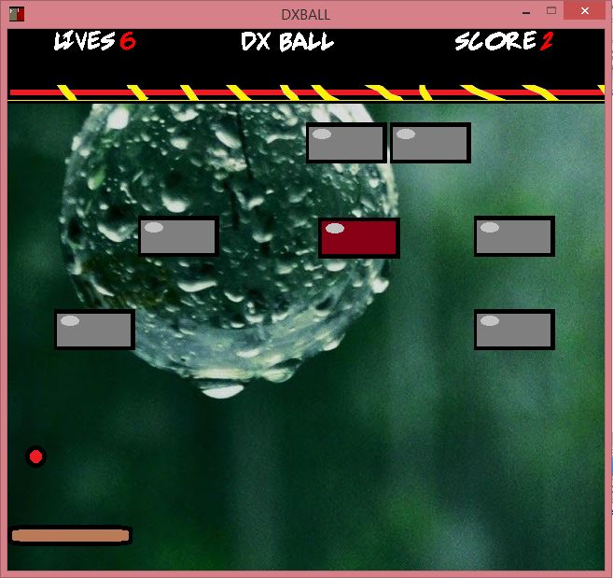
The Game:
In this game, the main objective of the player is to hit the red brick and earn points.
The red brick should be hit by the red ball which will move randomly.
If the red ball touches the ground, player loses a life.
A total loss of 10 lives will result game over.
To prevent the ball from touching the ground, player should move the horizontal base right or left via keyboard.

Slide 5
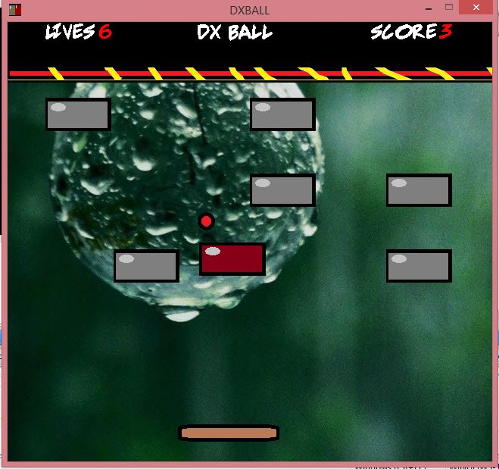
Obstacles
Displays the number of lives left.
This displays the no. of red bricks hit.
The red ball which is used to hit the brick.
The brick that should be hit to increase score.
The base that is controlled by the play to prevent the red ball from hitting the ground

Slide 6
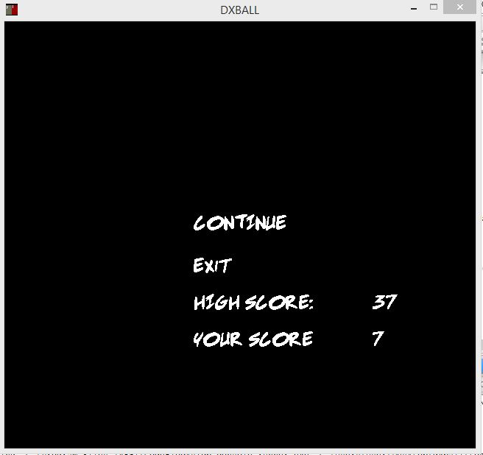
After loosing all 10 lives, the game will be over and a new screen will be displayed that will show the score and the option to continue or exit the game.

Slide 7
These are the objects of class brick1
This is the object of class ball.
Object Of Class brick2
Object of class paddle

Slide 8
For HighScore:
File operation was employed to include high score.
Fstream header file was used. It contains necessary definitions of functions used to manipulate file.
ifstream and ofstream classes were used to extract and store values in file.
If a user makes a score higher than the previous high score then the new score is set as high score and stored in file.
The high score is displayed in menu.

Slide 9
For HighScore:
File operation was employed to include high score.
Fstream header file was used. It contains necessary definitions of functions used to manipulate file.
ifstream and ofstream classes were used to extract and store values in file.
If a user makes a score higher than the previous high score then the new score is set as high score and stored in file.
The high score is displayed in menu.

Slide 10
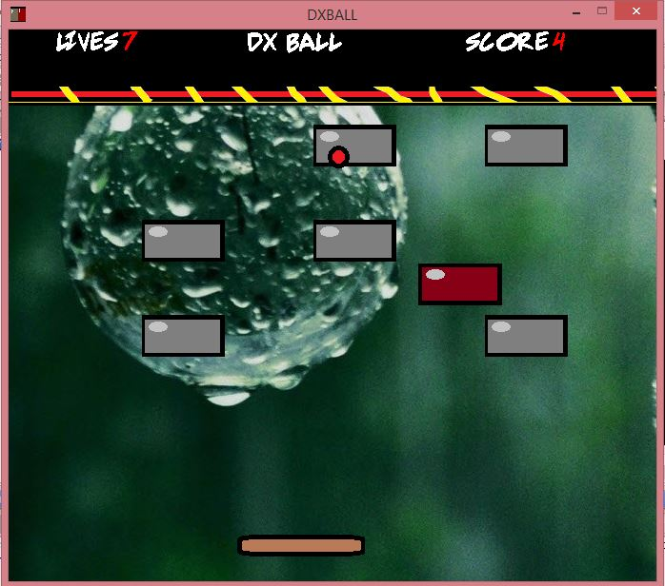
Error in the game:
There is an error while running the game.
During the gameplay, the red ball sometime gets stuck on the brown bricks(Obstacles) and then moves indide for a while like in the picture.

Slide 11
Removal of error:
To remove this error, a function was made which randomly changes the position of the obstacles into new positions as soon as the ball hits the brick 10 times.
This frees the ball and hence the error gets removed.
While placing the bricks into random position another function was made which makes sure that the bricks donot overlap each other.

Slide 12
What we learnt from this project:
From this project we learnt about SDL by the use of which we can apply graphics in C++.
With this project and these like projects ,we develop our confidence in doing much advanced and efficient projects in near future.
Last but not the least, this project made us to work in team which helped us understand the spirit of team work, division of task, communication which will of course, help us in the future.

